Slide 1


Exploratory Data Analysis (EDA) on Netflix Titles Dataset
Welcome to our exploration of the Netflix titles dataset.
MZ
by Mohammad Zaid

Slide 2

What is EDA?
1
Data Understanding
2
Hypothesis Testing
Uncover patterns and trends.
Validate assumptions about the data.
3
Data Cleaning
4
Feature Engineering
Identify and address inconsistencies.
Prepare data for analysis and modeling.

Slide 3
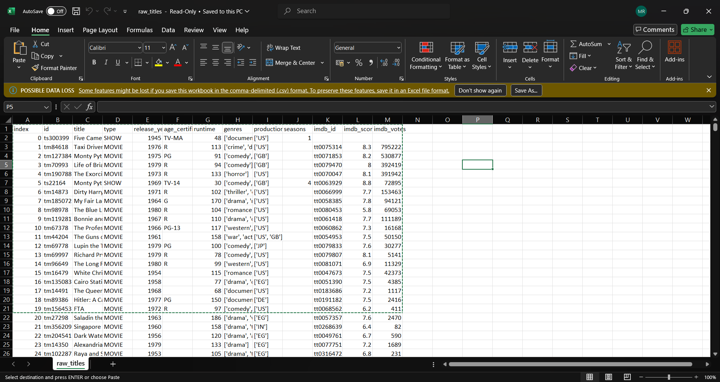

Dataset Overview
Title
Type
Release Year
Runtime
Genres
Production Countries
The Irishman
Movie
2019
209 min
Crime, Drama
United States
Stranger Things
TV Show
2016
50-80 min
Science Fiction, Horror
United States

Slide 4
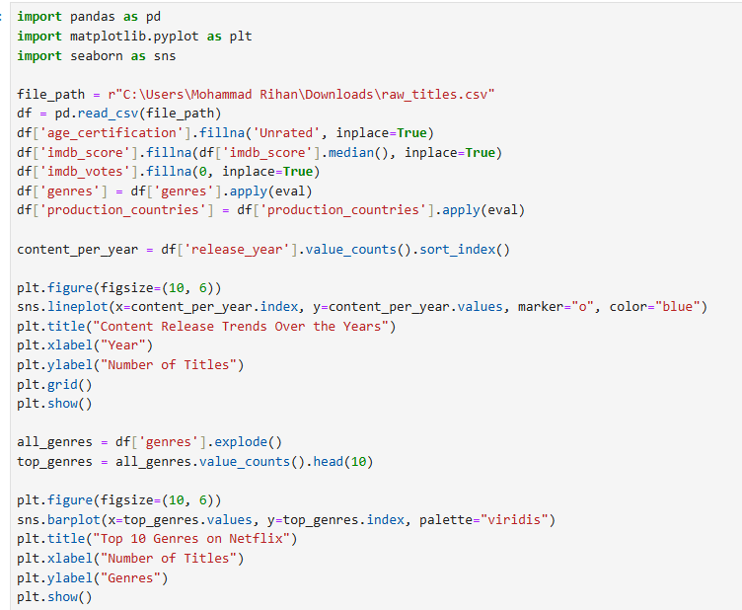
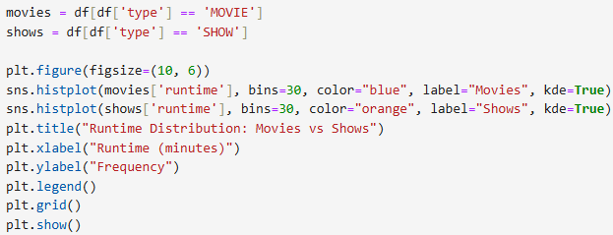
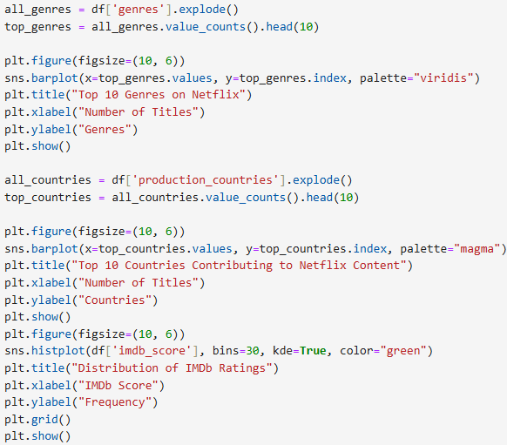

Slide 5
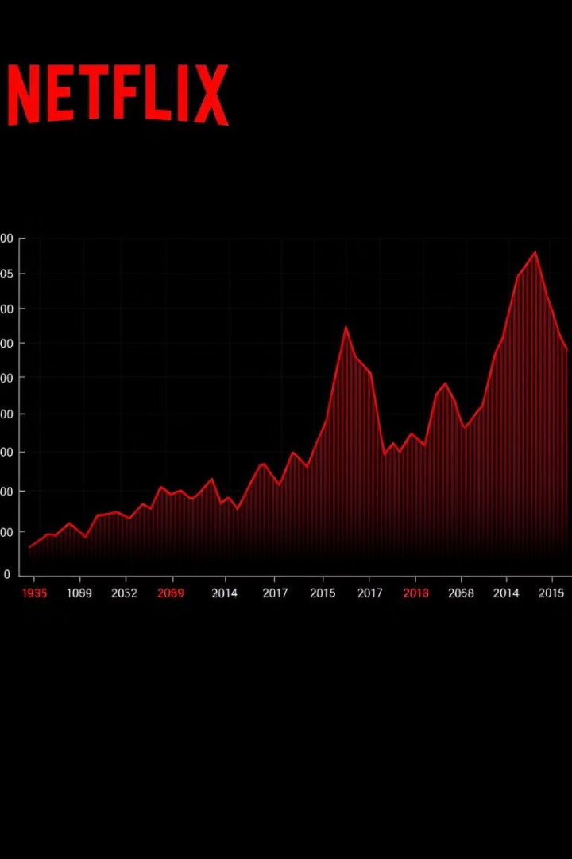
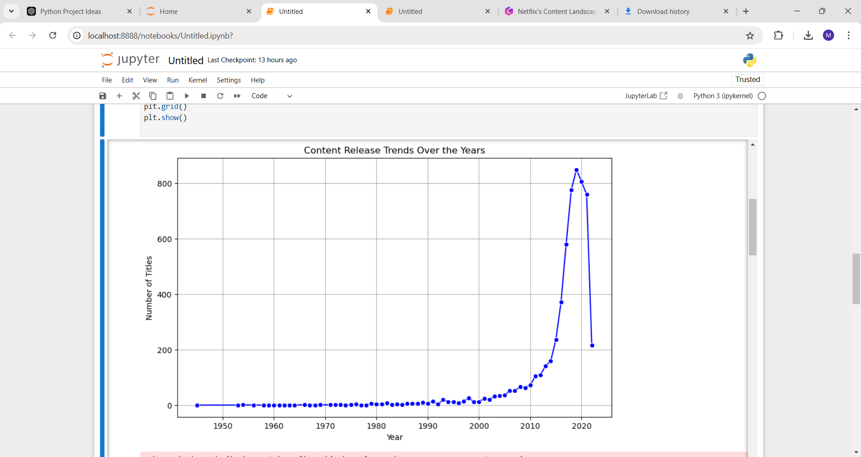
Content Release Trends
From 2000s
1
Steady growth in content releases.
2016-2020
2
Significant increase in content volume.
2021-Present
3
A notable peak occurred , and Continued
expansion and diversification in content.

Slide 6
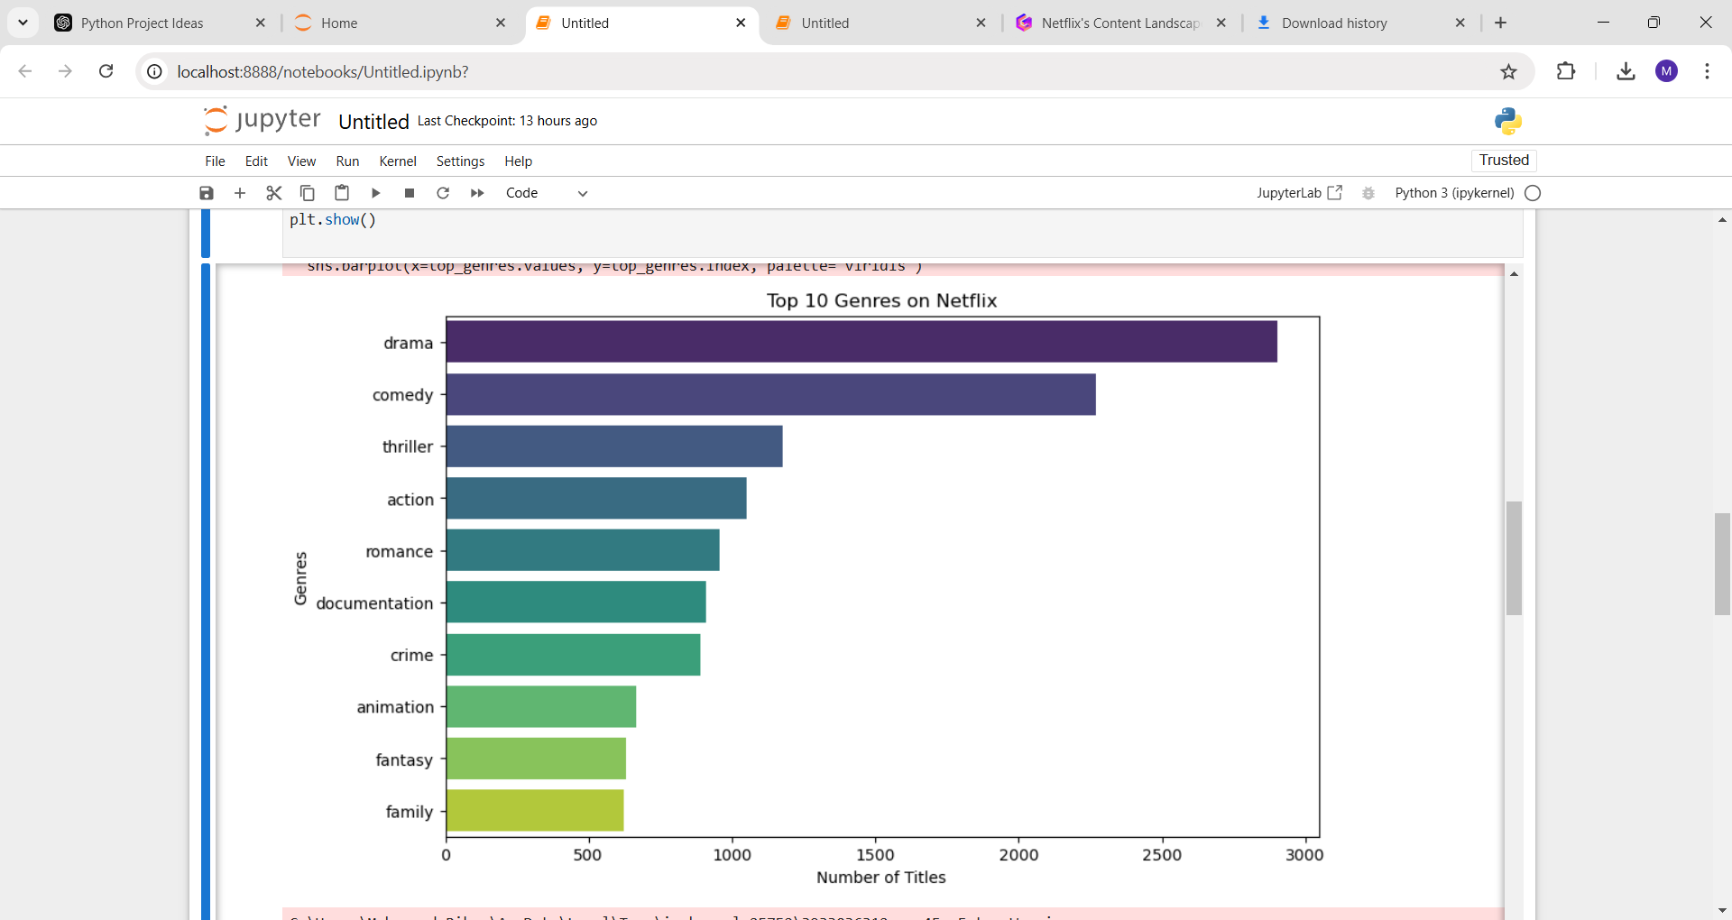
Top Genres
Drama
Most popular genre, with deep stories.
Comedy
High demand for lighthearted entertainment.
Action
Attracts viewers seeking adrenaline rush.

Slide 7
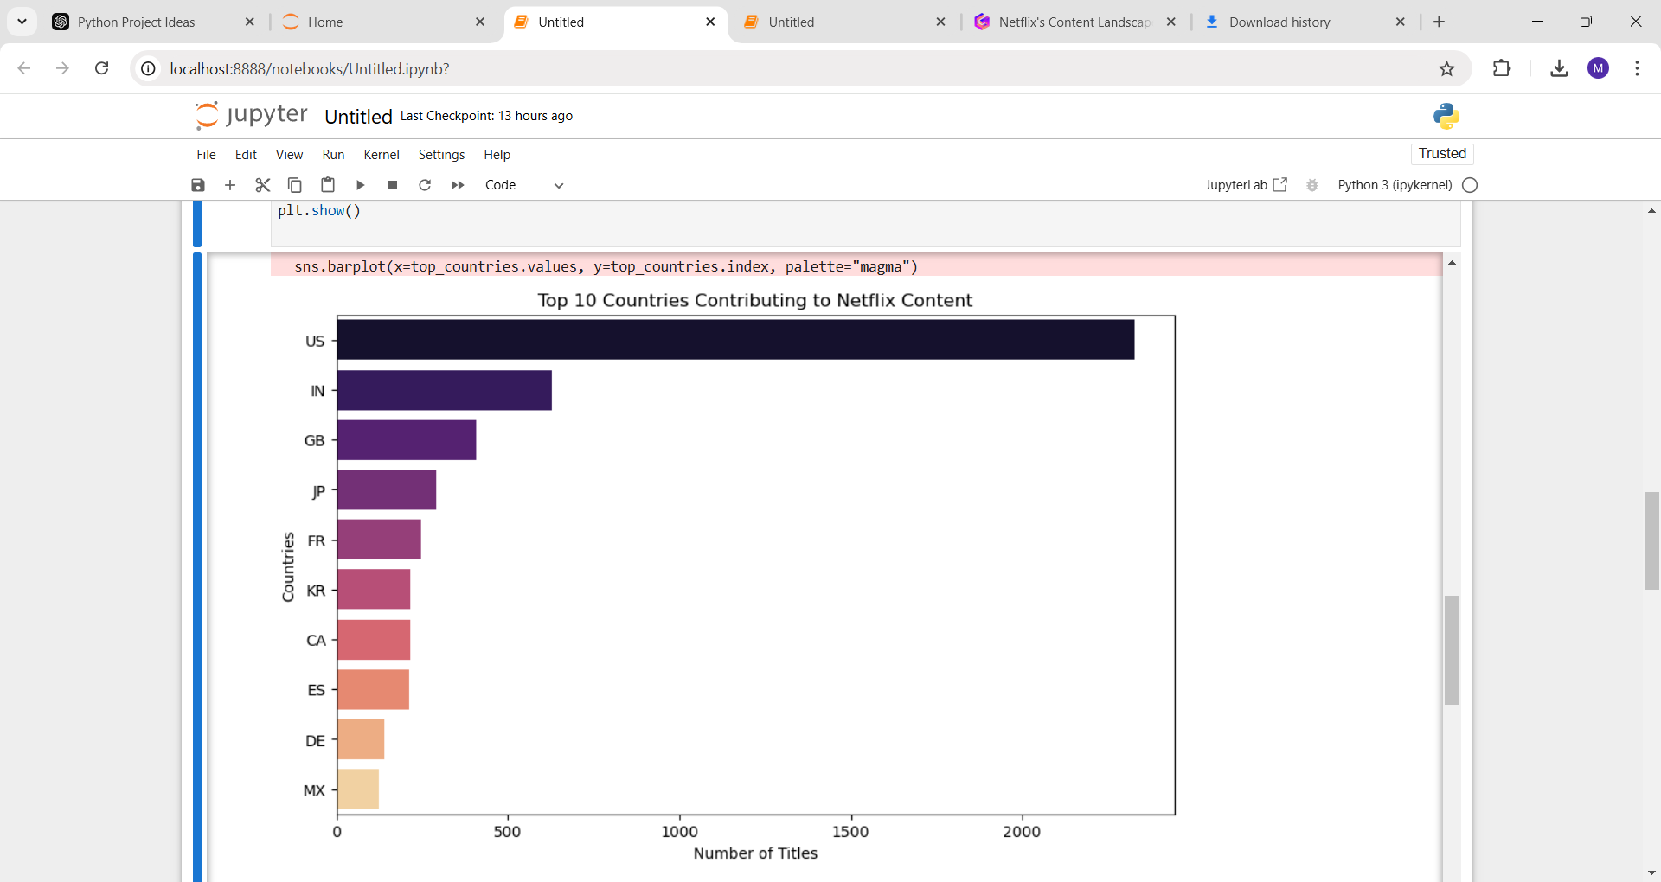
Country Contributions
USA
India
GB
Largest contributor to Netflix content.
Growing presence with diverse storytelling.
Strong presence with a variety of genres.

Slide 8
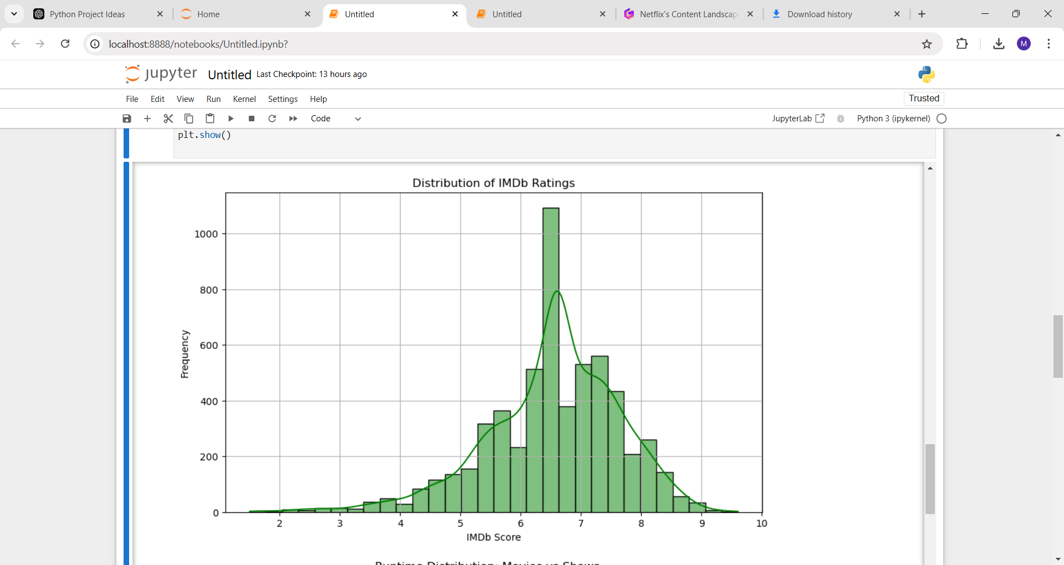
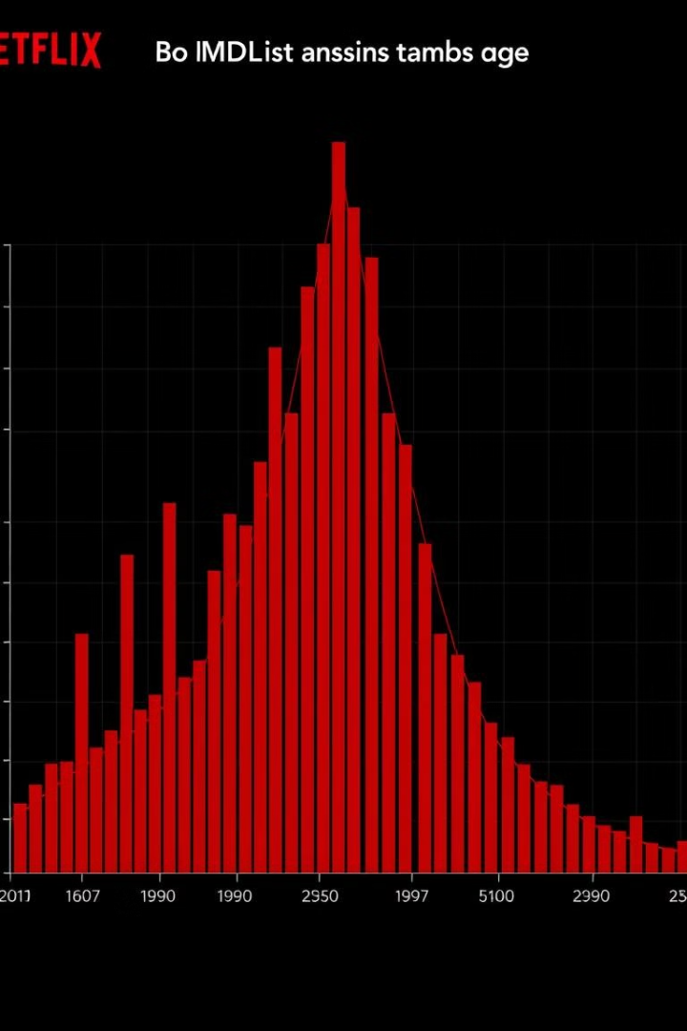
IMDb Ratings Distribution
Moderate Ratings
High Ratings
Majority of titles fall within average range.
A smaller portion of titles receive high scores.
Low Ratings
Few titles have exceptionally low
scores.

Slide 9
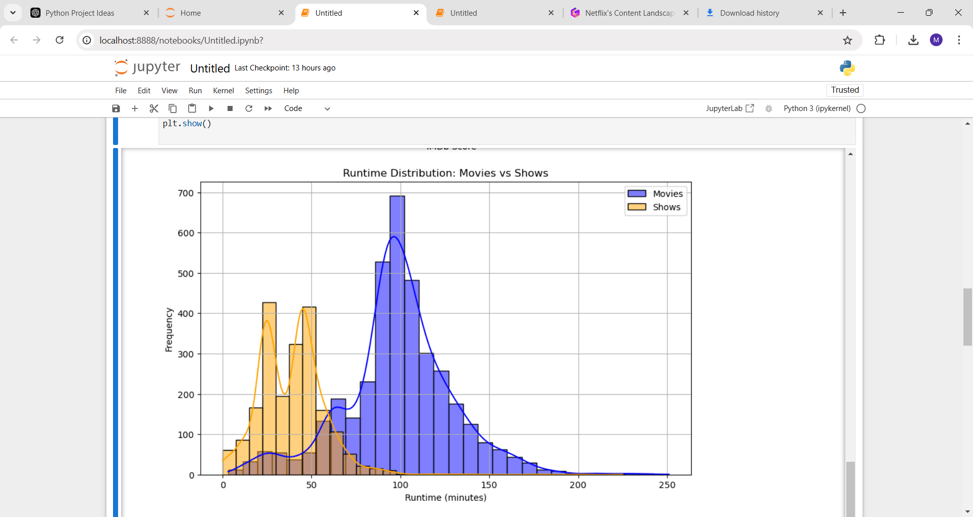
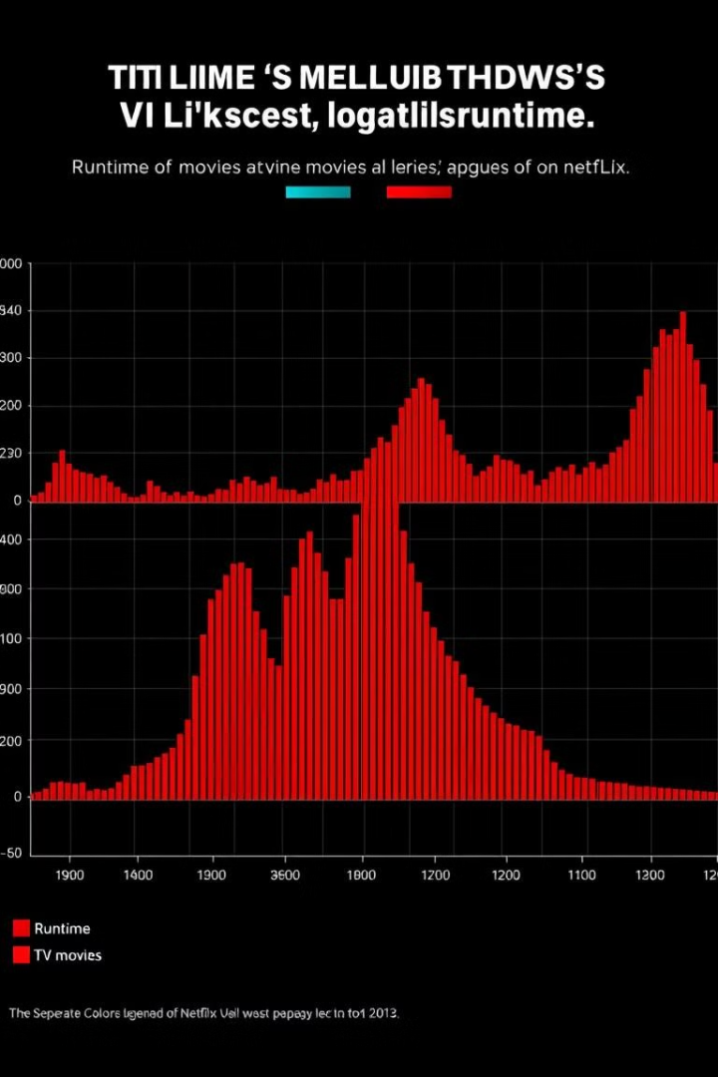


Runtime distribution
Movies
Shows
Wide range of runtimes, from
short to long.
Generally have shorter episode durations.

Slide 10
Objective of the Analysis
1
Content Growth
2
Genre Trends
Analyze Netflix's content expansion over time.
Identify popular genres and user preferences.
3
Global Reach
4
User Engagement
Explore content contributions from different countries.
Assess content quality through IMDb ratings.

Slide 11

Conclusion
1
Diverse Content
2
User Preferences
Netflix offers a wide range of titles across genres and countries.
Drama and Comedy are popular choices among viewers.
3
Content Quality
4
Future Scope
Netflix offers a balance of average and exceptional content.
This analysis can inform future content strategies.

